Slide 1
onVENUE SYSTEM
Submitted By
ALPHONS BABY
(ADM.No: 20MCA-010)
Guided By
Mr. ANISH AUGUSTINE
(Assistant Professor)
of
MASTER OF COMPUTER APPLICATIONS
DEPARTMENT OF COMPUTER APPLICATIONS
St. Joseph's College of Engineering and Technology, Palai, Kottayam-686579

Slide 2
TABLE OF CONTENTS
CHAPTER PAGE No.
1.Introduction About Project……………………………………………………………2
2.Project Background..............................................................................................3
3.Scope of the Project.............................................................................................5
4. Data Flow Diagram……………………………………………………………………6
5. Table Design.........................................................................................................9
6. Form Design..........................................................................................................13 7.Conclusion………………………………………………………………………………..30
8.Reference………………………………………………………………………………...31

Slide 3
1.Introduction About Project
As we know there are many venues available in the ﬁeld of college. This include facilities like conference halls, seminar hall, college space auditoriums etc. In early stages, staff used to book these venues manually. This process was time consuming and included lot of paper works. It has been very hard to book these venues. Now, staff can book these venues through online platforms. They don’t have to go anywhere to avail these venues. By checking the availability of venue, the staff can book this venue through online and book these venues for a short period of time. It also helps to simplify the venue booking process and raise the efficiency in management.

Slide 4
2. Project Background
This application is developed using Python Django Framework. Django is a Python-based free and open-source web framework that enables rapid development of secure and maintainable .The interface of this application is designed using bootstrap. Bootstrap is the most popular HTML, CSS and java script framework for developing responsive web pages. Visual Studio code is the Integrated Development Environment(IDE) used for this application. Back end of this application is developed using MySQL. MySQL is an open-source relational database management system.

Slide 5
Module Description
Admin
This is the module which has access to the software and it holds all the details of the staff, venues. Here the admin can approve the booking of venue and also send booking status of venue.
Staff
The main purpose of this module is booking of venues in the college. Here the staff can view the details of venue, notifications and also cancel the booked venue.

Slide 6
3.Scope of the Project
The existing system is completely manual. The staff can book venues manually. There are lot of paper works and time consuming.
In the proposed system, the staff need not go anywhere he can just get all information about venues in a single click. The staff needs to login, so that he can select the venues and can book by checking the availability. It is possible for the staff to access the details regarding the venues from anywhere around the globe.

Slide 7
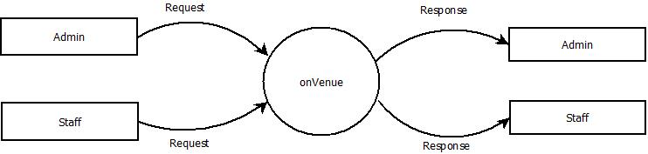
4. Data Flow Diagram
Level-0

Slide 8
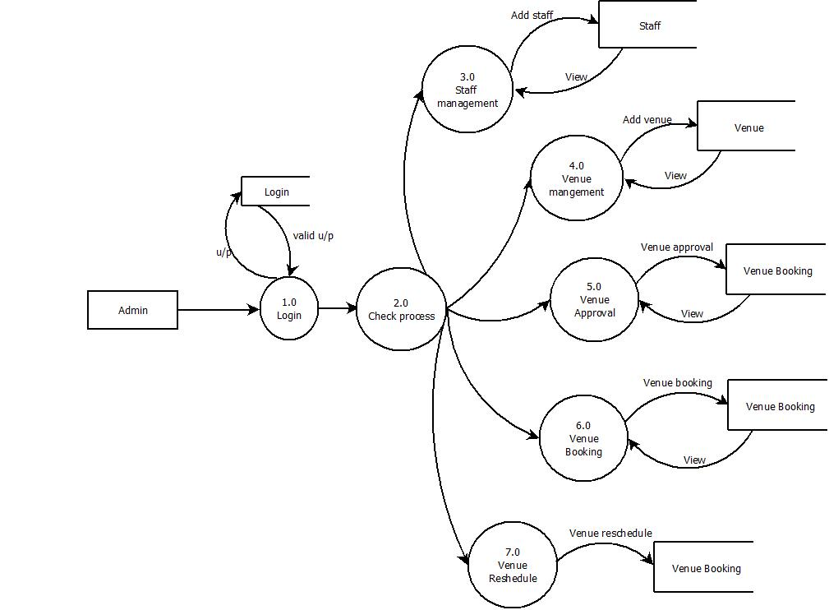
Level-1.1

Slide 9
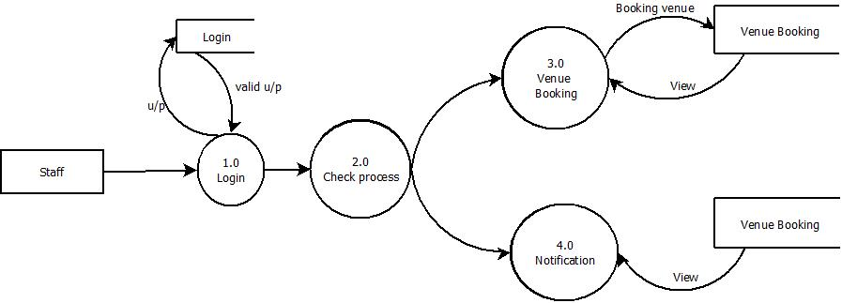
Level-1.2

Slide 10
5. Table Design
Table name: Login
FILED NAME | DATA TYPE | LENGTH | KEY | DESCRIPTION
id | int | 50 | Primary key
username | varchar | 50 | Foreign key references to table addstaff | Username for admin and other modules
password | varchar | 50 |  | Password for admin and other modules
Role | varchar | 50 |  | Role of admin and other modules

Slide 11
TABLE NAME: Staff
FILED NAME | DATA TYPE | LENGTH | KEY | DESCRIPTION
StaffId | Varchar | 50 | Primary key | Identity number of staff
StaffName | Varchar | 50 |  | Name of staff
Dest | Varchar | 50 |  | Destination of staff
Department | Varchar | 50 |  | Department of staff
Course | Varchar | 50 |  | Course of staff
Qualification | Varchar | 50 |  | Qualification of staff
dateofbirth | Date | 50 |  | Date of birth of staff
Gender | Varchar | 50 |  | Gender number of staff
Address | Varchar | 50 |  | Address of staff
Photo | file |  |  | photo of staff

Slide 12
TABLE NAME:Venue
FILED NAME | DATA TYPE | LENGTH | KEY | DESCRIPTION
Venue_id | Varchar | 50 | Primary key | Identity of Venue
Venue_name | Varchar | 50 |  | Name of Venue
Location | Varchar | 50 |  | Location of Venue
Description | Varchar | 50 |  | Description of Venue
Seat | Varchar | 50 |  | Seating capacity of venue

Slide 13
TABLE NAME: Venue Booking
FILED NAME | DATA TYPE | LENGTH | KEY | DESCRIPTION
Bid | Varchar | 50 | Primary key | Identity of venue booking
StaffId | Varchar | 50 | Foreign key references to table Staff | StaffId of staff
Venue_id | Varchar | 50 | Foreign key references to table addVenue | id of Venue
Eventname | Varchar |  |  | name of event conducted in the Venue
Description | Varchar | 50 |  | Approval or rejected Description of Venue
Start date | Date |  |  | Starting Time of meeting
End date | Date |  |  | Ending Time of meeting
No of person | Varchar | 50 |  | No of person in the meeting
HPL | file | 50 |  | HOD permission letter
Status | Varchar | 50 |  | Coordinator approval

Slide 14
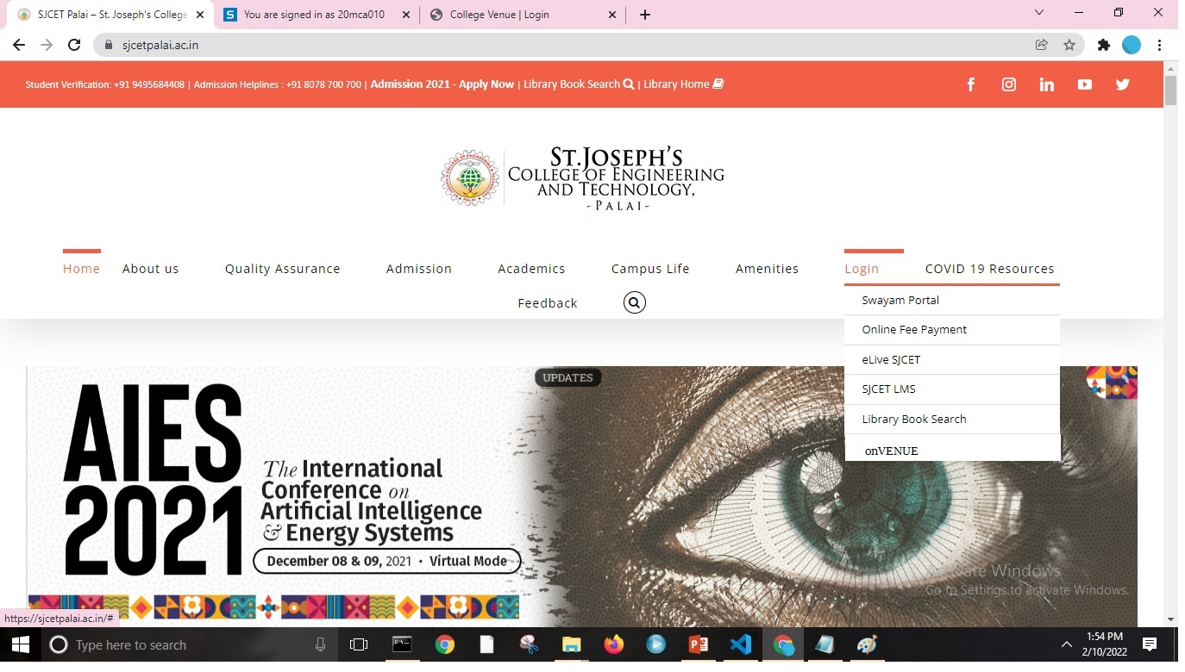
6. Form Design
Home page

Slide 15
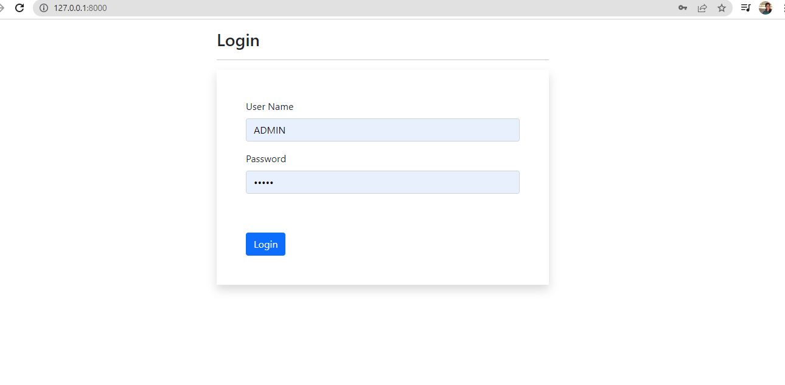
Login page

Slide 16
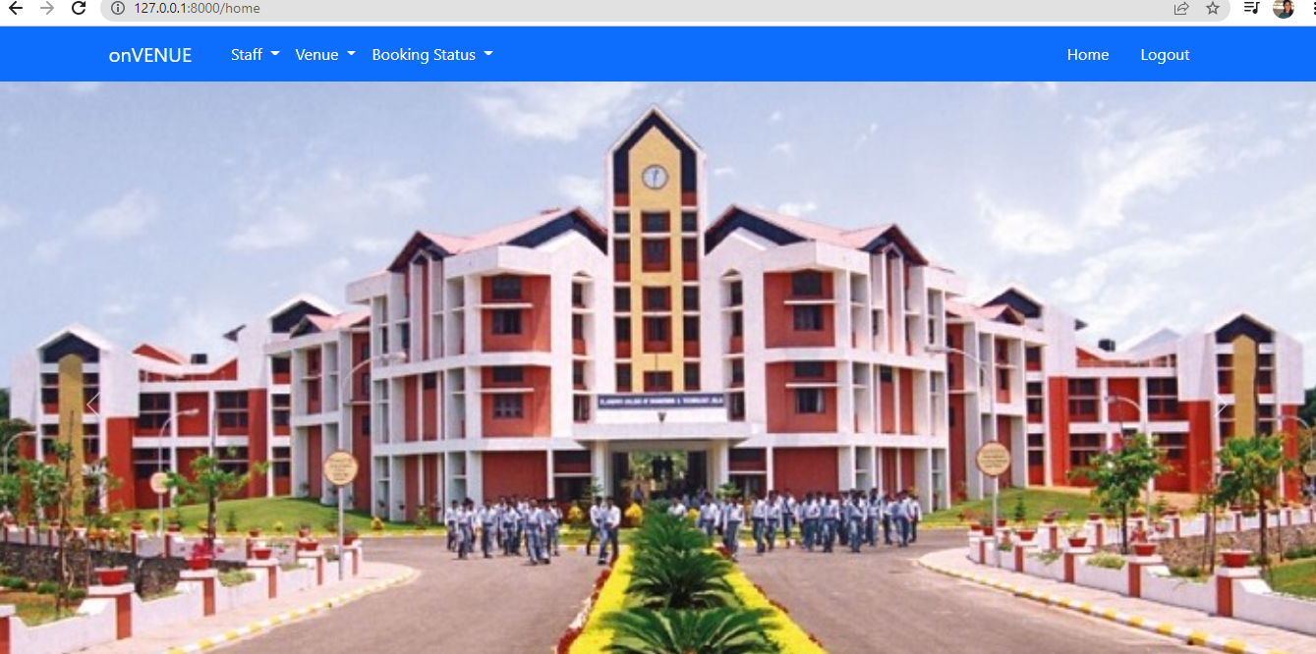
Admin home page

Slide 17
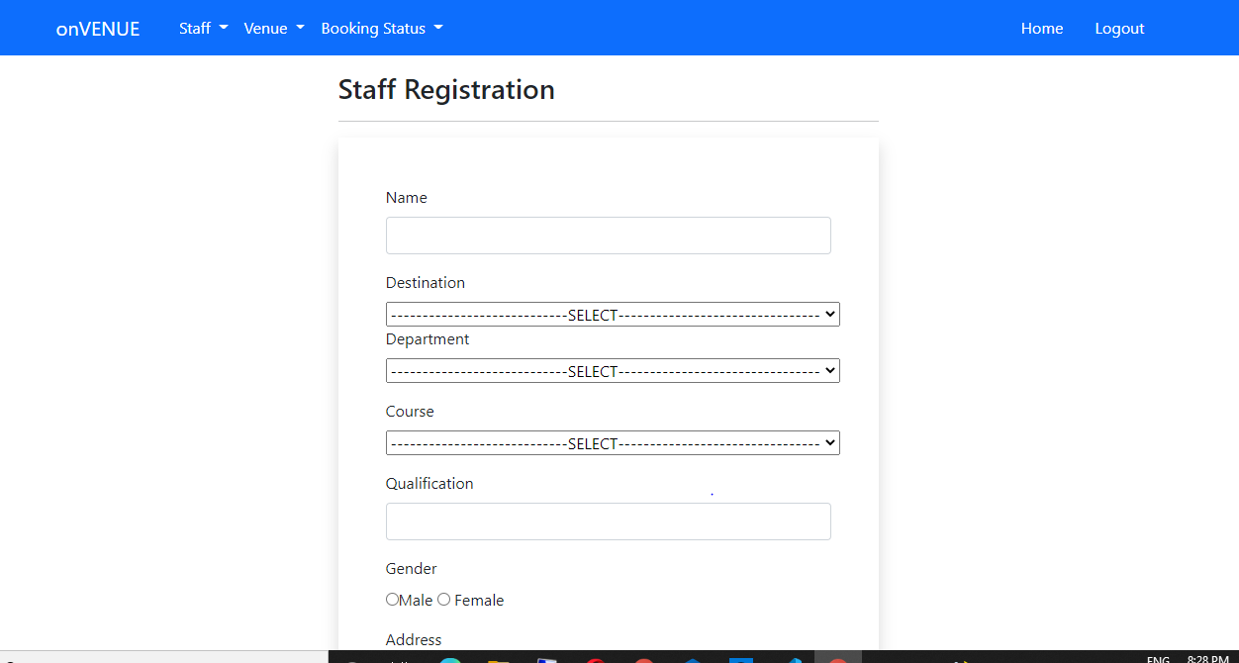
Staff Registration form

Slide 18
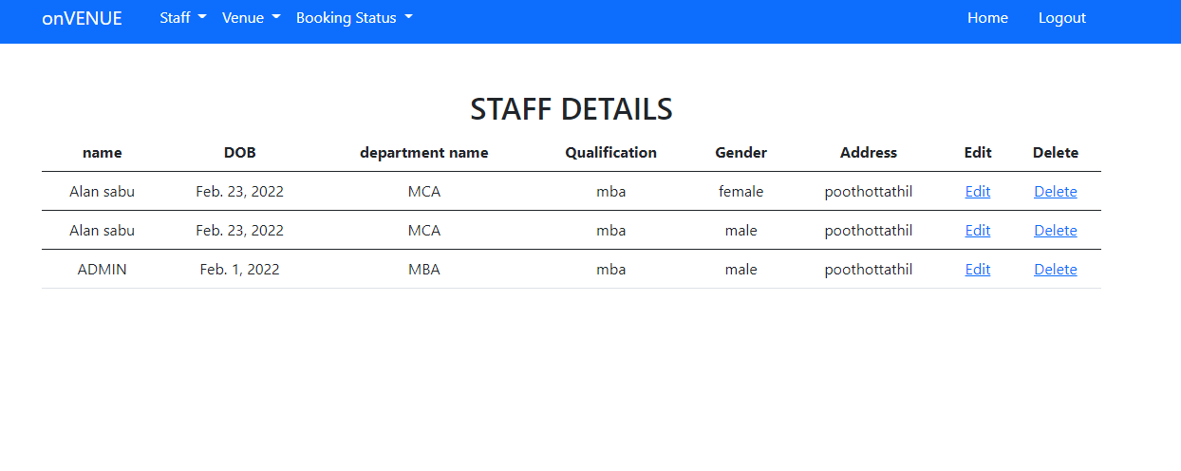
Staff Details form

Slide 19
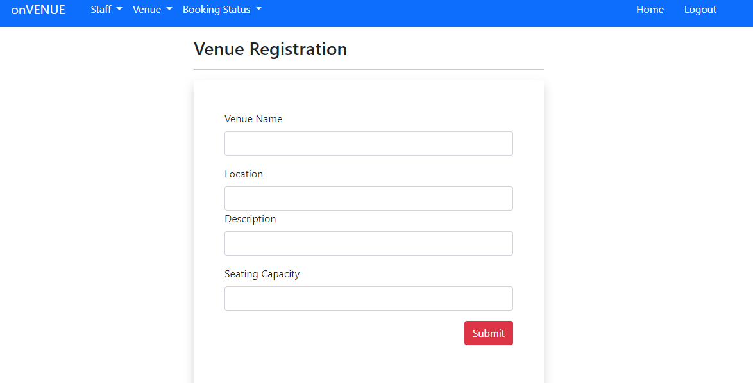
Venue Registration form

Slide 20
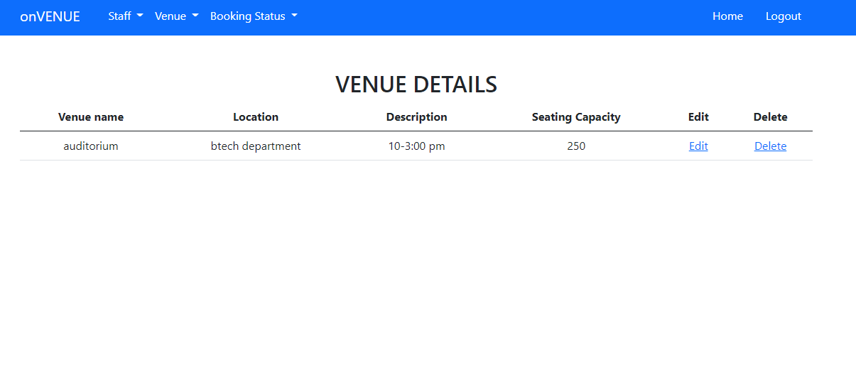
venue Details form

Slide 21
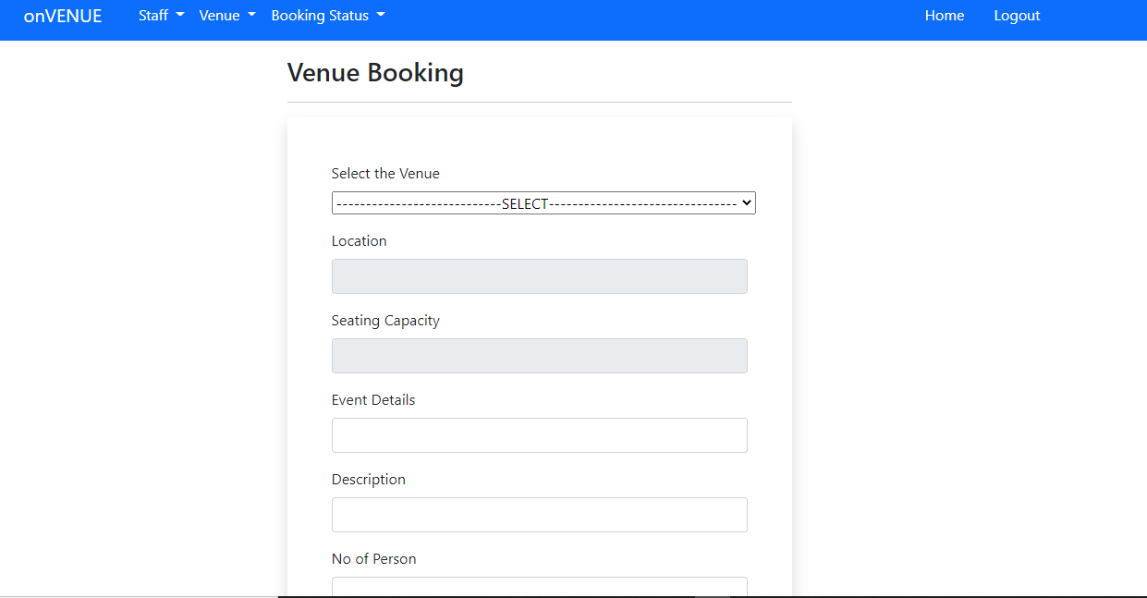
Venue Booking form

Slide 22
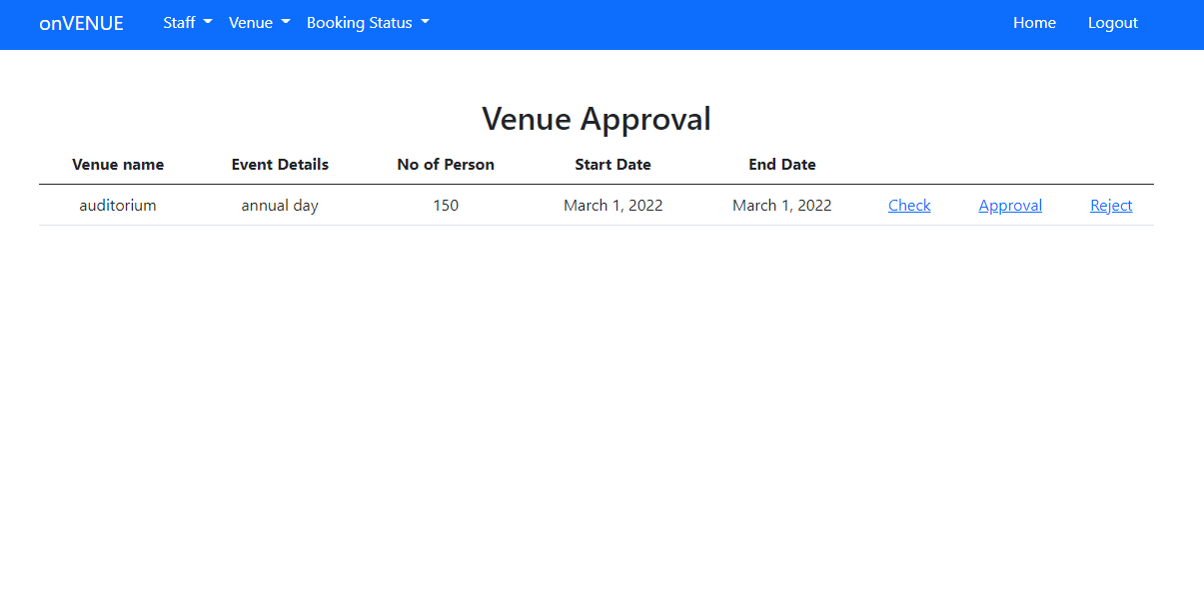
Venue Approval/reject form

Slide 23
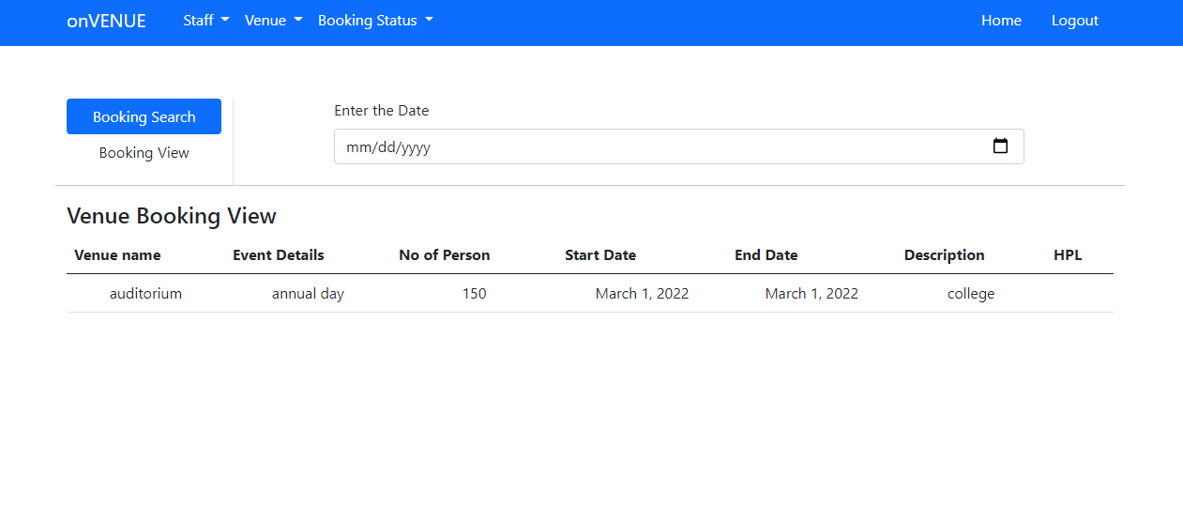
Booking status form

Slide 24
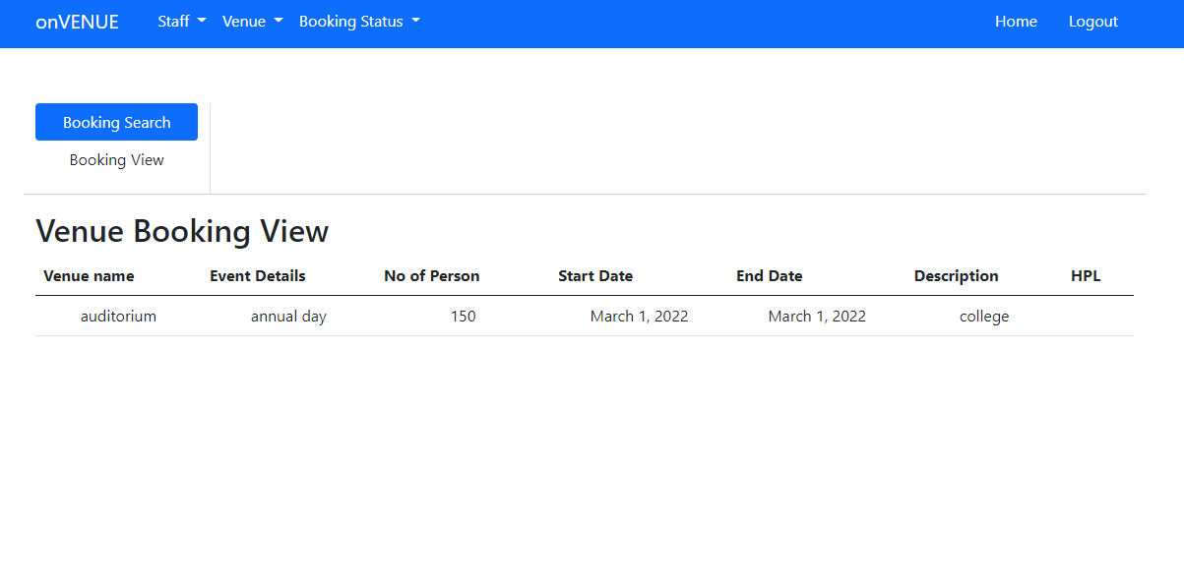
Booking status form

Slide 25
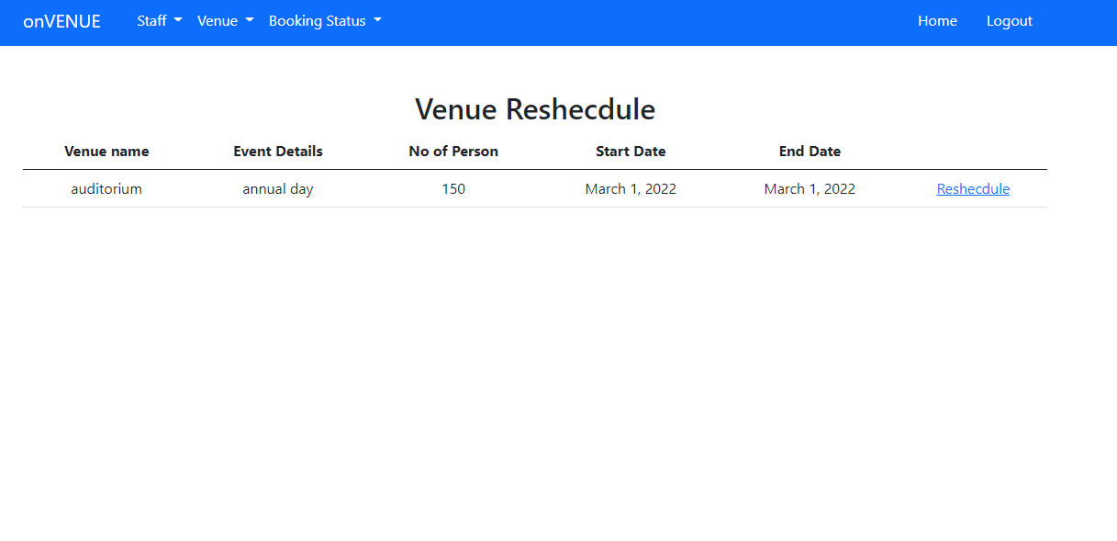
Venue reschedule form

Slide 26
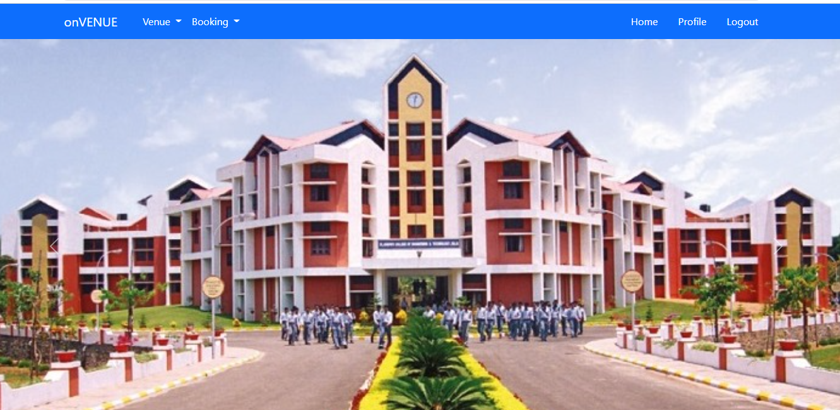
Staff Home page

Slide 27
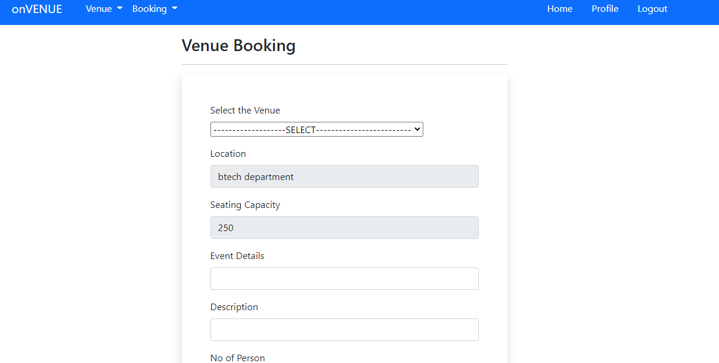
Venue Booking form

Slide 28
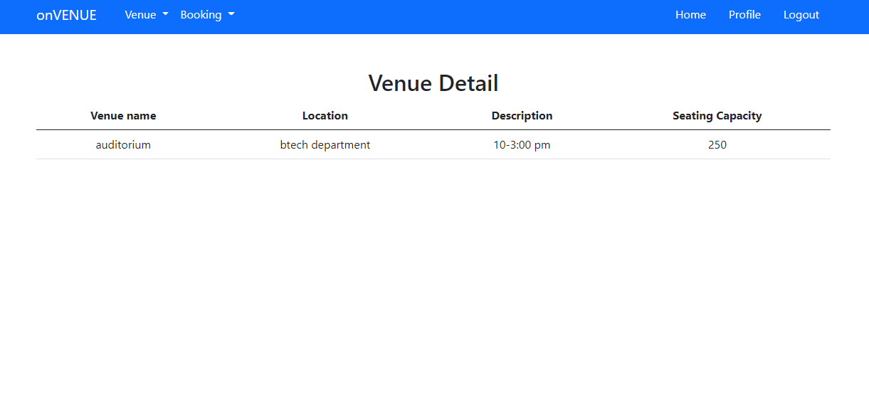
venue Details form

Slide 29
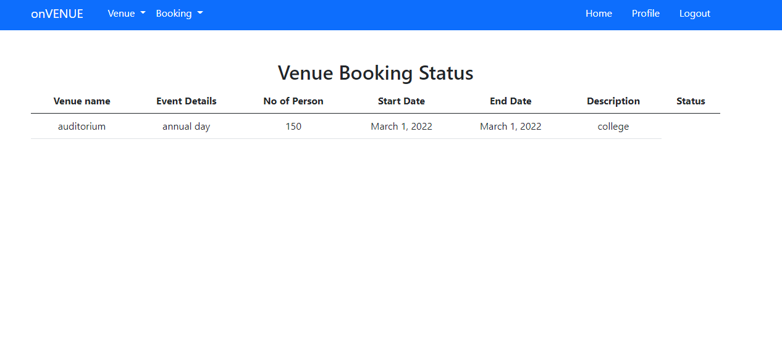
Venue booking status

Slide 30
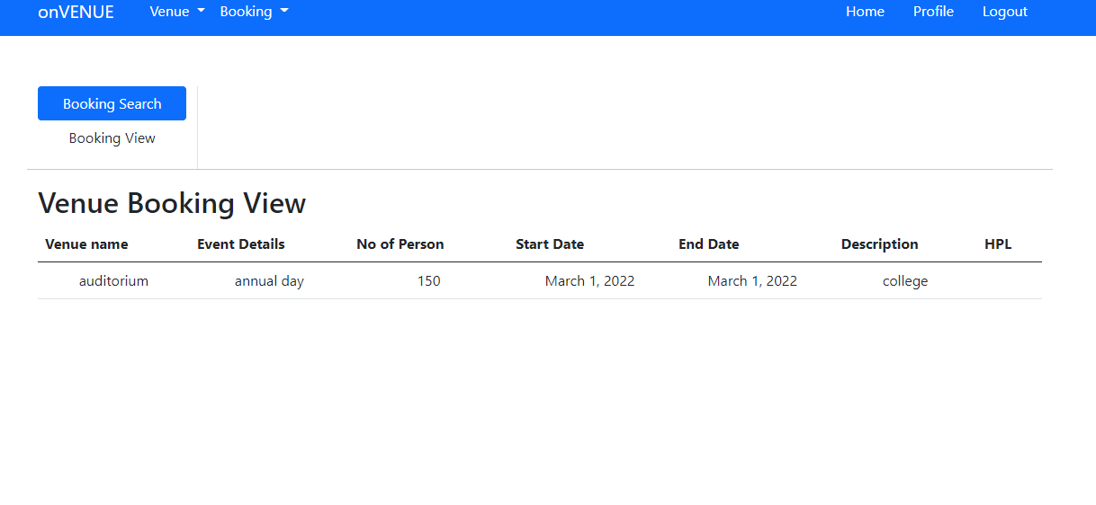
Booking status form

Slide 31
7.Conclusion
In today’s fast growing world, manual booking of venues is something that requires a change. Booking things online are the way of new world. The procedures involved in manual booking can now be completed in just a few clicks. My project venues booking management system in a great way by avoiding time wastage and many other unwanted expense. I hope that it will create high level of advancements in the ﬁeld of College and other ﬁelds.

Slide 32
8.Reference
Bootstrap Tutorial, https://www.w3schools.com/bootstrap/
Django Tutorial :https://www.djangoproject.com/
Django Tutorial :https ://www.udemy.com/course/python-django-the-practical-guide/learn/lecture

Slide 33
Needs to Complete
Calendar view of booking.
Validation.
Data base operation .
Adding Bootstrap.
Configuration (back end and front end).

Slide 34
THANK YOU

